Slide 1
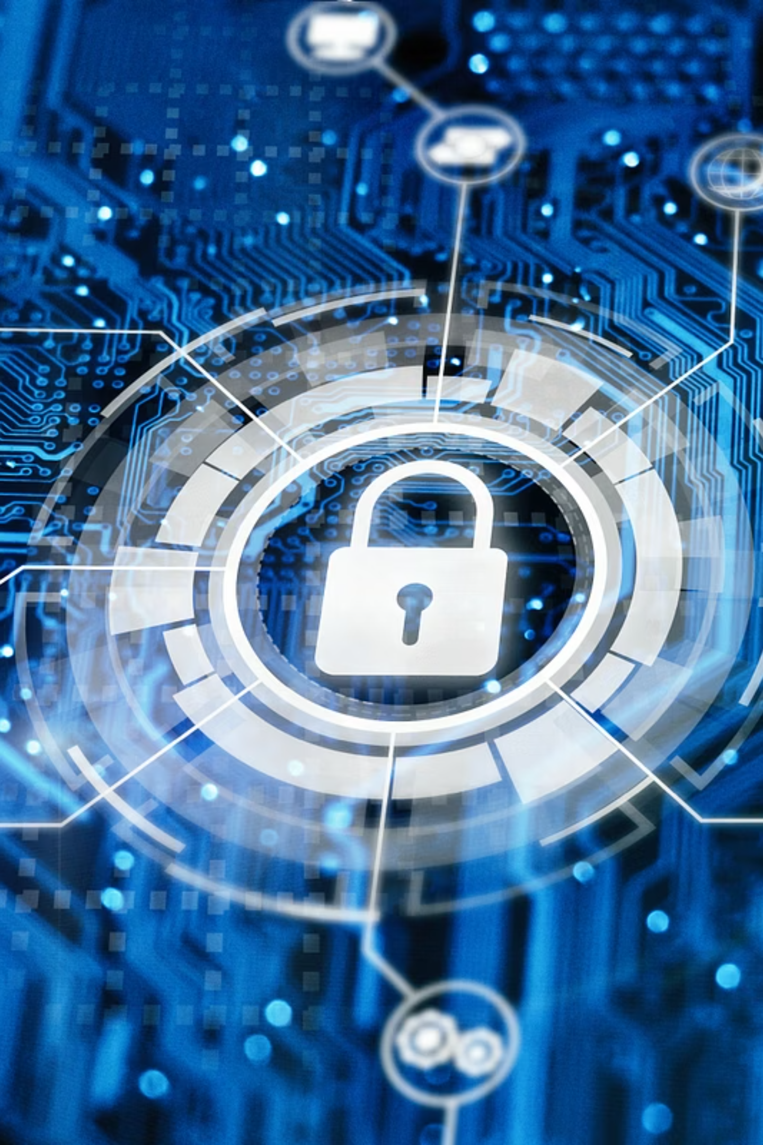
Phishing Awareness Training
Safeguarding Our Digital World

Slide 2
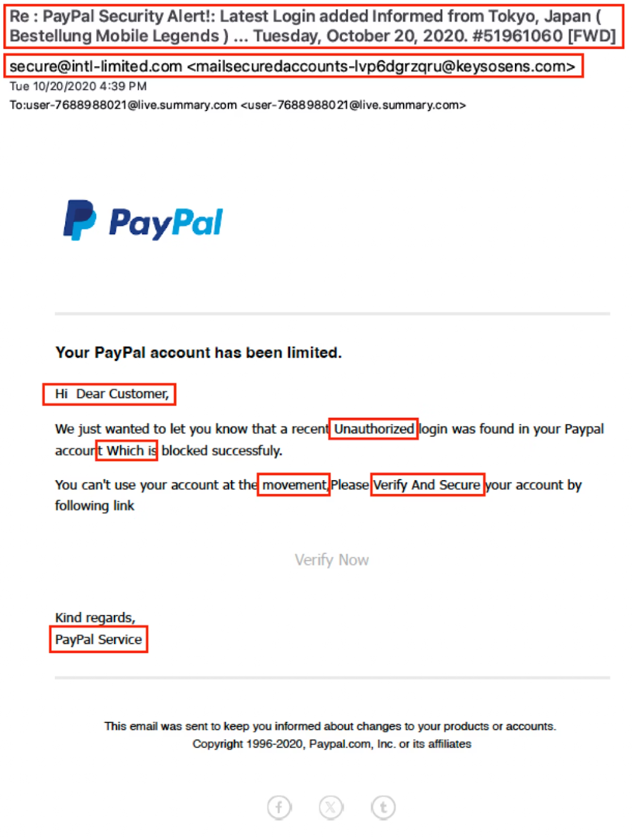
Understanding Phishing: A Growing Threat
Phishing is a deceptive cyberattack where malicious actors attempt to trick individuals into revealing sensitive information, such as usernames, passwords, and credit card details, often by masquerading as a trustworthy entity.
This pervasive threat continues to evolve, making it crucial for everyone to understand its mechanisms. Phishing attacks are a primary vector for data breaches and financial fraud, impacting both individuals and organisations globally.
Why it's serious:
Leads to identity theft and financial loss.
Compromises organisational security and data integrity.
Can facilitate further cyberattacks like ransomware.

Slide 3





Common Types of Phishing Attacks
Phishing attacks come in various forms, each designed to exploit different vulnerabilities. Understanding these types helps in better recognising and defending against them.
Email Phishing
Spear Phishing
Whaling
Broad attacks via email, aiming to trick many recipients into clicking malicious links or downloading infected attachments.
Highly targeted attacks customised for specific individuals, often using personal information to appear legitimate.
A form of spear phishing targeting high-profile individuals like CEOs or executives, seeking access to critical company data.
Smishing
Vishing
Phishing attempts conducted via SMS messages, often containing malicious links or requests for personal information.
Voice phishing, where attackers use phone calls to impersonate legitimate entities and trick victims into divulging sensitive data.

Slide 4
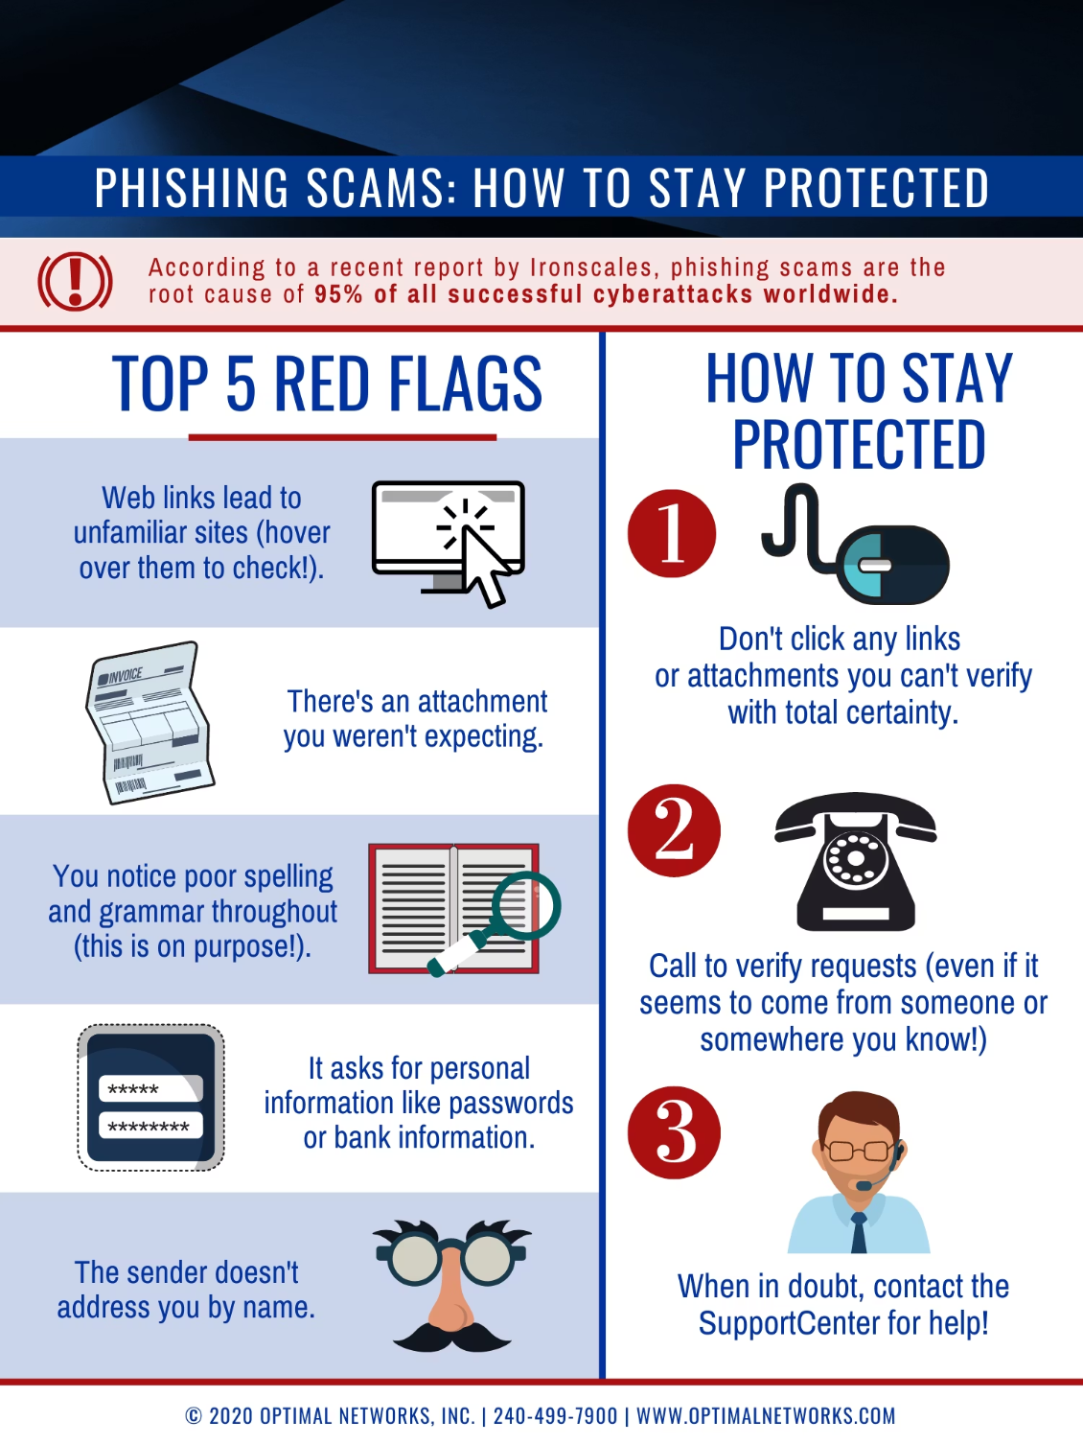
Recognising Phishing Emails: Red Flags
Phishing emails often contain tell-tale signs that can help you identify them. Always be vigilant and look for these common red flags:
Suspicious Sender Address: Mismatched or unusual email addresses.
Urgent or Threatening Language: Demands immediate action or warns of dire consequences.
Generic Greetings: "Dear Customer" instead of your name.
Spelling and Grammatical Errors: Professional organisations rarely send emails with mistakes.
Suspicious Links: Hover over links to see the actual URL before clicking.
Unexpected Attachments: Never open attachments from unknown senders.

Slide 5
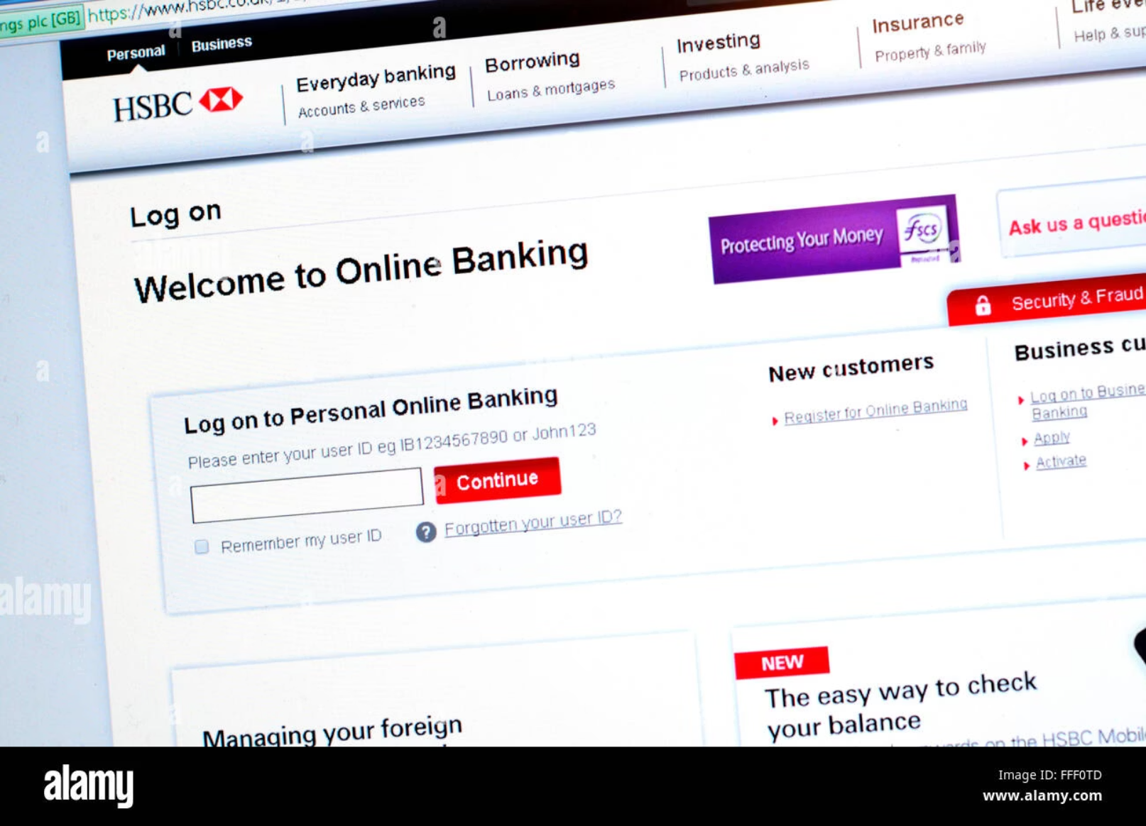
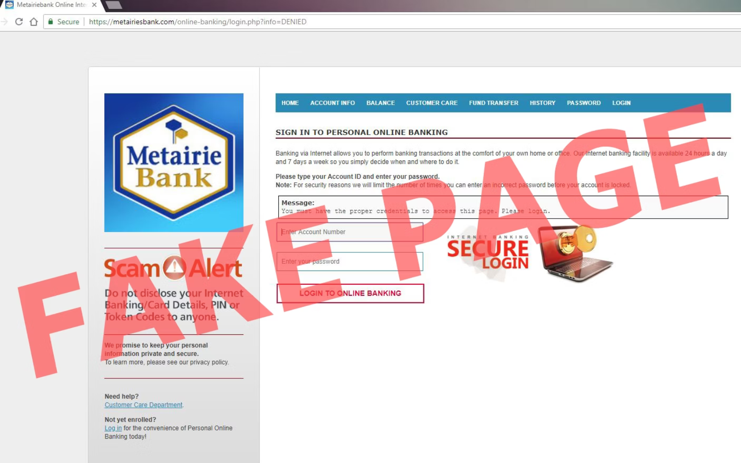
Spotting Fake Websites: A Visual Guide
Phishing attacks often direct you to fake websites designed to steal your credentials. Learn to differentiate legitimate sites from fraudulent ones.
Real Website
Fake Website
HTTPS: Always check for "https://" in the URL and a padlock icon.
No HTTPS or Red Flag: Missing "s" or browser warnings.
Correct Domain: The URL matches the official website exactly.
Lookalike Domains: Subtle misspellings or extra characters (e.g., "amaz0n.com").
Professional Design: High-quality graphics and consistent branding.
Poor Design: Blurry images, inconsistent fonts, or awkward layouts.
Legitimate Offers: Realistic promotions and services.
Pop-up Forms: Aggressive pop-ups demanding personal information.
Too-Good-To-Be-True Offers: Unrealistic discounts or prizes.

Slide 6
Social Engineering Tactics Used in Phishing
Attackers often exploit human psychology to manipulate victims. Understanding these tactics can help you resist their schemes.
Authority
Urgency
Scarcity
Impersonating a boss, IT support, or government official to demand compliance.
Creating a false sense of immediate need to bypass critical thinking (e.g., "Account will be suspended in 24 hours!").
Suggesting limited availability of an offer or resource to pressure quick decisions.
Fear
Greed
Threatening negative consequences (e.g., legal action, account closure) to induce panic and hasty actions.
Promising unrealistic rewards (e.g., lottery winnings, huge discounts) to entice victims.

Slide 7
Best Practices to Avoid Phishing
Proactive measures are your best defence against phishing attacks. Incorporate these habits into your daily digital routine.
Verify Senders
Hover Over Links
Always double-check the sender's email address and contact them directly through official channels if unsure.
Before clicking, hover your mouse over any link to see the actual URL. If it looks suspicious, do not click.
Enable Multi-Factor Authentication (MFA)
Update Software Regularly
MFA adds an extra layer of security, making it harder for attackers to access your accounts even if they steal your password.
Keep your operating system, web browser, and antivirus software updated to protect against known vulnerabilities.
Avoid Password Reuse
Report Suspicious Messages
Use unique, strong passwords for all your accounts. Consider using a password manager.
If you receive a suspicious email or message, report it to your IT department or email provider.

Slide 8
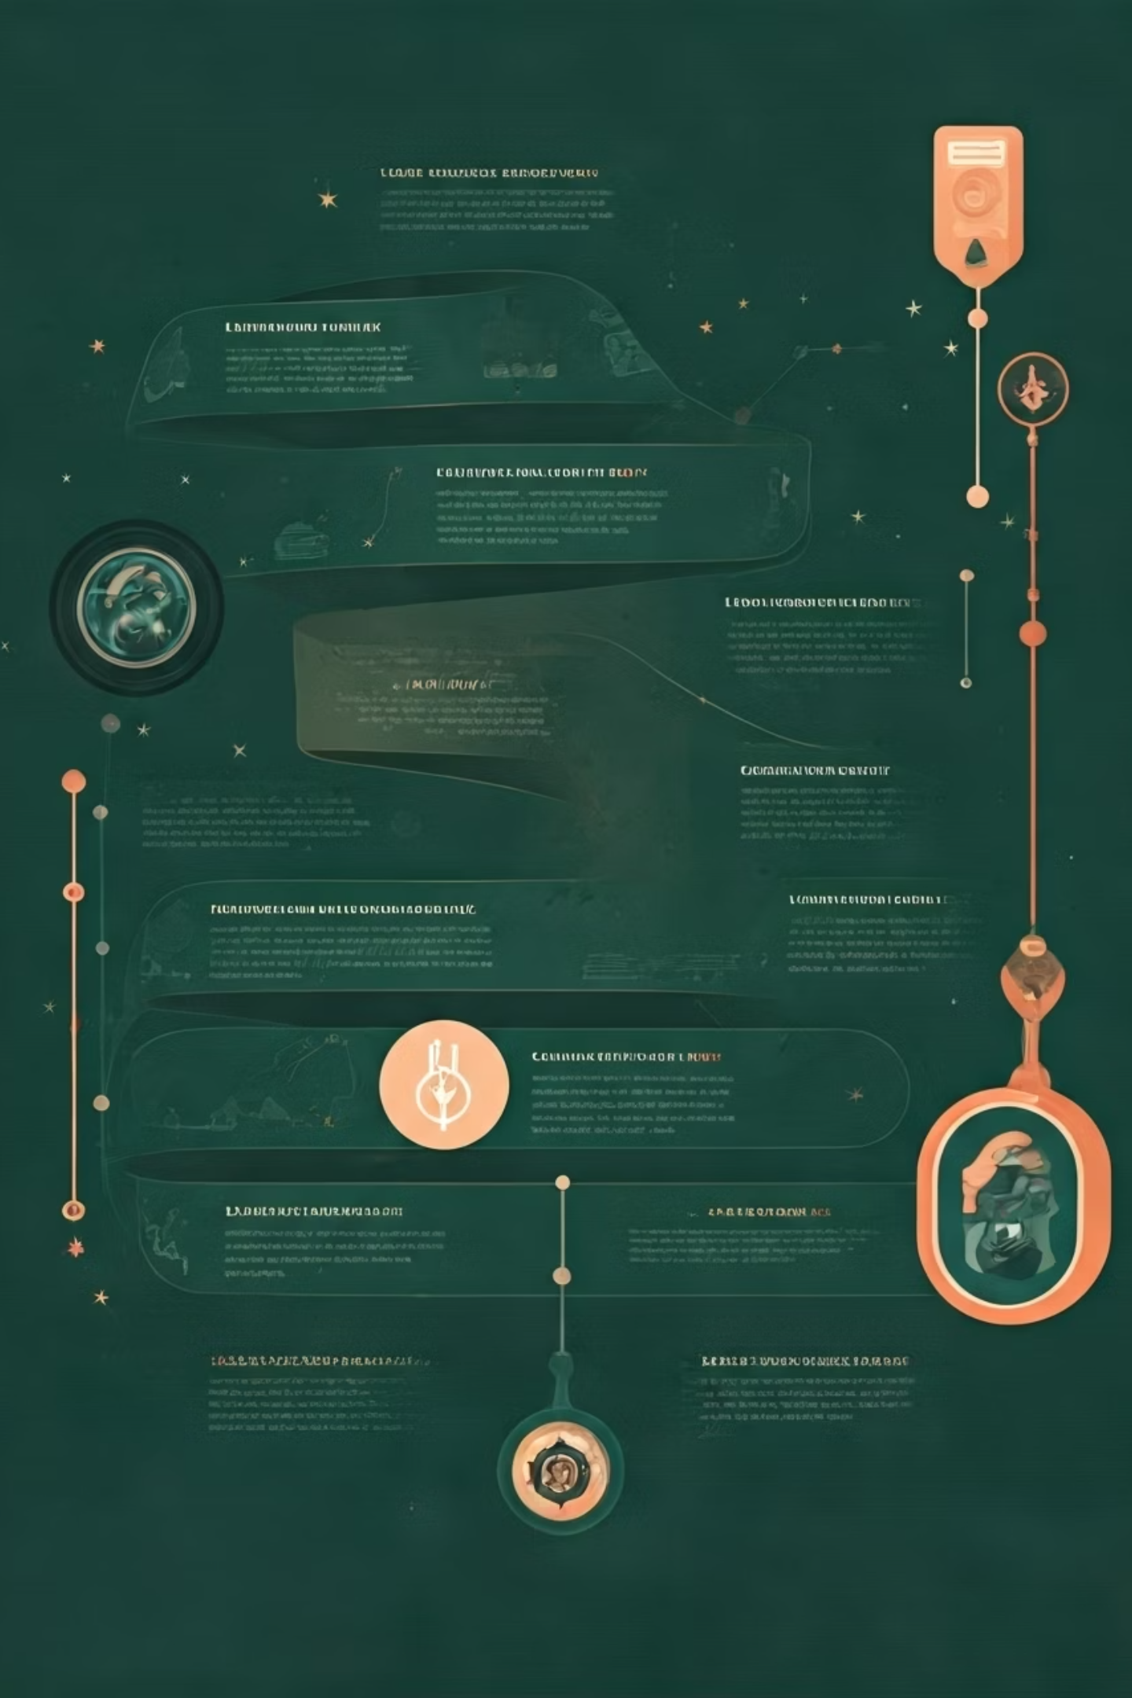
Real-World Phishing Case Studies
These incidents highlight the significant impact phishing can have on organisations and individuals.
1
2013: Target Data Breach
Attackers gained access to Target's systems via a phishing email sent to a third-party HVAC vendor, compromising data of 40 million customers.
2
2016-2017: Google & Facebook Scam
A Lithuanian man defrauded Google and Facebook of over $100 million through a phishing scheme involving fake invoices.
3
2017: WannaCry Ransomware
The WannaCry ransomware spread rapidly, primarily through phishing emails containing malicious attachments, impacting organisations worldwide.

Slide 9

Interactive Quiz: Test Your Phishing Awareness!
Let's see how well you can identify and respond to potential phishing threats.
Question 1: True or False?
Question 2: Multiple Choice
Question 3: True or False?
It's safe to click on a link in an email if it comes from someone you know.
Multi-Factor Authentication (MFA) can prevent account compromise even if your password is stolen.
Which of these is a red flag for a phishing email?
A) Generic greeting
B) Spelling errors
C) Urgent request for personal info
D) All of the above
(Answer the question in comment section)

Slide 10



Summary & Final Tips: Stay Secure!
Your vigilance is our strongest defence against phishing attacks. Remember these key takeaways:
Think Before You Click
Verify Before Sharing
Stay Updated
Always pause and evaluate the legitimacy of emails and messages before taking any action.
Never provide sensitive information without independently verifying the request through official channels.
Keep your software, security knowledge, and awareness of new threats current.
Thank you for your attention and commitment to cybersecurity!

